Slide 1
Keys
Values
“Eminem”
45
“Rihana”
30
“Drake”
31

Slide 2
Keys
Values
“Eminem”
“Rap God”
“Love the way you lie”
“Rihana”
“Umbrella”
“Love the way you lie”
“Drake”
“In My feelings”
“God’s Plan”

Slide 3
Keys
Values
“2018”
“Lucky You”
“Kamikaze”
“Eminem”
“Eminem”
“2017”
“River”
“Like Home”
“2018”
“”
“River”
“Drake”
“2017”
“In my feelings”
“God’s Plan”

Slide 4


Functions – An Analogy
Sam Smith
Ami, Bank of Taiwan
Hello , My name is Sam Smith
Hello, Sam this is Ami from Bank of Taiwan
May I Know My bank balance?
Sure, It is 600,450$ only.
Ok Thanks… Bye.

Slide 5
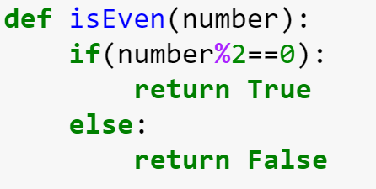
Def Keyword
Function Name
Parameter
Return Keyword
Return Value

